Slide 1
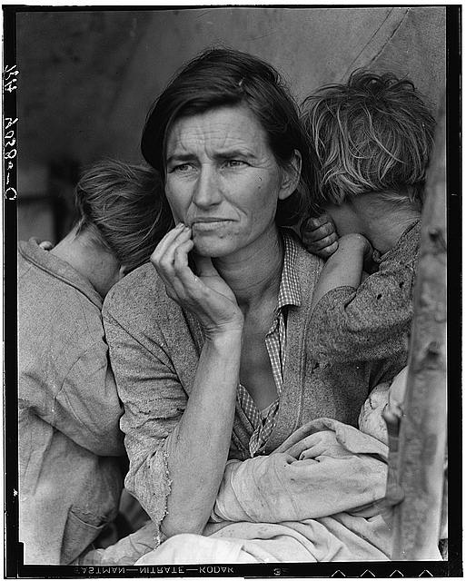
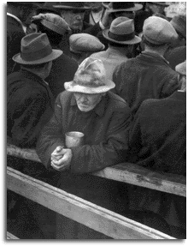
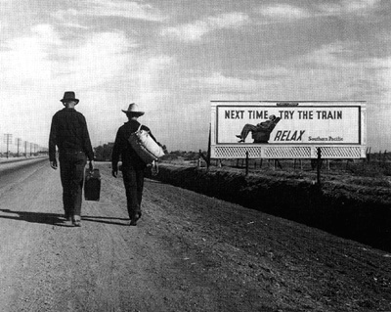
THE GREAT DEPRESSION BEGINS
Photos by photographer Dorothea Lange

Slide 2
SECTION 1: THE NATION’S SICK ECONOMY
As the 1920s advanced, serious problems threatened the economy while
Important industries struggled, including:
Agriculture
Railroads
Textiles
Steel
Mining
Lumber
Automobiles
Housing
Consumer goods

Slide 3
FARMERS STRUGGLE
No industry suffered as much as agriculture
During World War I European demand for American crops soared
After the war demand plummeted
Farmers increased production sending prices further downward
Photo by Dorothea Lange

Slide 4
CONSUMER SPENDING DOWN
By the late 1920s, American consumers were buying less
Rising prices, stagnant wages and overbuying on credit were to blame
Most people did not have the money to buy the flood of goods factories produced

Slide 5
GAP BETWEEN RICH & POOR
The gap between rich and poor widened
The wealthiest 1% saw their income rise 75%
The rest of the population saw an increase of only 9%
More than 70% of American families earned less than $2500 per year
Photo by Dorothea Lange

Slide 6
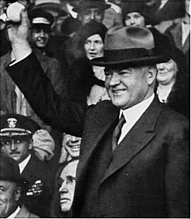
HOOVER WINS 1928 ELECTION
Republican Herbert Hoover ran against Democrat Alfred E. Smith in the 1928 election
Hoover emphasized years of prosperity under Republican administrations
Hoover won an overwhelming victory

Slide 7
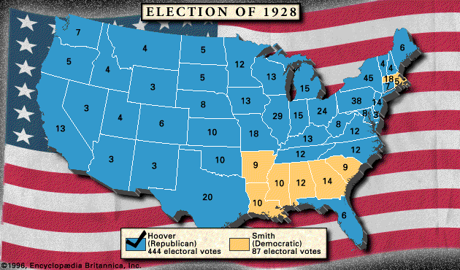

Slide 8
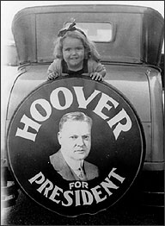
Young Hoover supporter in 1928

Slide 9
THE STOCK MARKET
By 1929, many Americans were invested in the Stock Market
The Stock Market had become the most visible symbol of a prosperous American economy
The Dow Jones Industrial Average was the barometer of the Stock Market’s worth
The Dow is a measure based on the price of 30 large firms

Slide 10
STOCK PRICES RISE THROUGH THE 1920s
Through most of the 1920s, stock prices rose steadily
The Dow reached a high in 1929 of 381 points (300 points higher than 1924)
By 1929, 4 million Americans owned stocks
New York Stock Exchange

Slide 11
SEEDS OF TROUBLE
By the late 1920s, problems with the economy emerged
Speculation: Too many Americans were engaged in speculation – buying stocks & bonds hoping for a quick profit
Margin: Americans were buying “on margin” – paying a small percentage of a stock’s price as a down payment and borrowing the rest
The Stock Market’s bubble was about to break

Slide 12
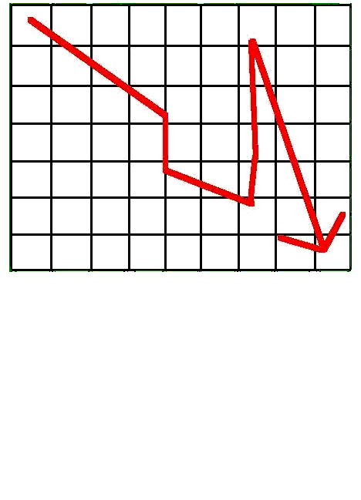
THE 1929 CRASH
In September the Stock Market had some unusual up & down movements
On October 24, the market took a plunge . . .the worst was yet to come
On October 29, now known as Black Tuesday, the bottom fell out
16.4 million shares were sold that day – prices plummeted
People who had bought on margin (credit) were stuck with huge debts

Slide 13
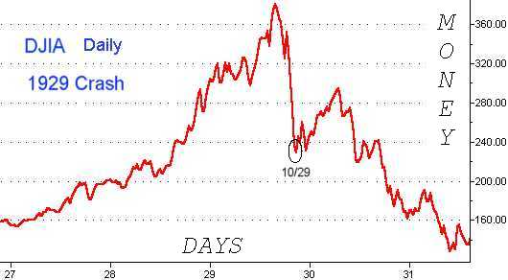
By mid-November, investors had lost about $30 billion

Slide 14
THE GREAT DEPRESSION
The Stock Market crash signaled the beginning of the Great Depression
The Great Depression is generally defined as the period from 1929 – 1940 in which the economy plummeted and unemployment skyrocketed
The crash alone did not cause the Great Depression, but it hastened its arrival
Alabama family, 1938 Photo by Walter Evans

Slide 15
FINANCIAL COLLAPSE
After the crash, many Americans panicked and withdrew their money from banks
Banks had invested in the Stock Market and lost money
In 1929- 600 banks fail
By 1933 – 11,000 of the 25,000 banks nationwide had collapsed
Bank run 1929, Los Angeles

Slide 16
GNP DROPS, UNEMPLOYMENT SOARS
Between 1928-1932, the U.S. Gross National Product (GNP) – the total output of a nation’s goods & services – fell nearly 50% from $104 billion to $59 billion
90,000 businesses went bankrupt
Unemployment leaped from 3% in 1929 to 25% in 1933

Slide 17
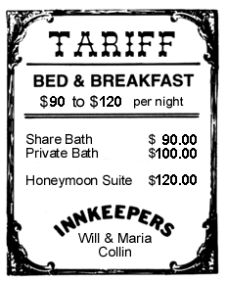
HAWLEY-SMOOT TARIFF
The U.S. was not the only country gripped by the Great Depression
Much of Europe suffered throughout the 1920s
In 1930, Congress passed the toughest tariff in U.S. history called the Hawley- Smoot Tariff
It was meant to protect U.S. industry yet had the opposite effect
Other countries enacted their own tariffs and soon world trade fell 40%

Slide 18
CAUSES OF THE GREAT DEPRESSION
Tariffs & war debt policies
U.S. demand low, despite factories producing more
Farm sector crisis
Easy credit
Unequal distribution of income

Slide 19
SECTION 2: HARDSHIPS DURING DEPRESSION
The Great Depression brought hardship, homelessness, and hunger to millions
Across the country, people lost their jobs, and their homes
Some built makeshifts shacks out of scrap material
Before long whole shantytowns (sometimes called Hoovervilles in mock reference to the president) sprung up

Slide 20
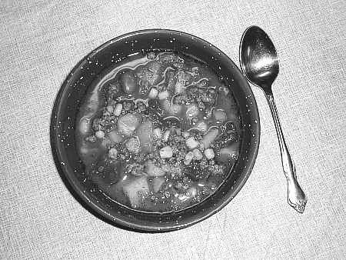
SOUP KITCHENS
One of the common features of urban areas during the era were soup kitchens and bread lines
Soup kitchens and bread lines offered free or low-cost food for people
Unemployed men wait in line for food – this particular soup kitchen was sponsored by Al Capone

Slide 21
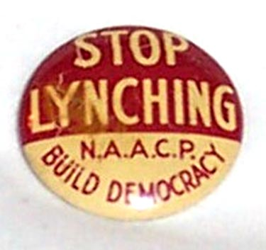
CONDITIONS FOR MINORITIES
Conditions for African Americans and Latinos were especially difficult
Unemployment was the highest among minorities and their pay was the lowest
Increased violence (24 lynchings in 1933 alone) marred the 1930s
Many Mexicans were “encouraged” to return to their homeland
As conditions deteriorated, violence against blacks increased

Slide 22
RURAL LIFE DURING THE DEPRESSION
While the Depression was difficult for everyone, farmers did have one advantage; they could grow food for their families
Thousands of farmers, however, lost their land
Many turned to tenant farming and barely scraped out a living
Between 1929-1932 almost ½ million farmers lost their land

Slide 23
THE DUST BOWL
A severe drought gripped the Great Plains in the early 1930s
Wind scattered the topsoil, exposing sand and grit
The resulting dust traveled hundreds of miles
One storm in 1934 picked up millions of tons of dust from the Plains an carried it to the East Coast
Kansas Farmer, 1933

Slide 24
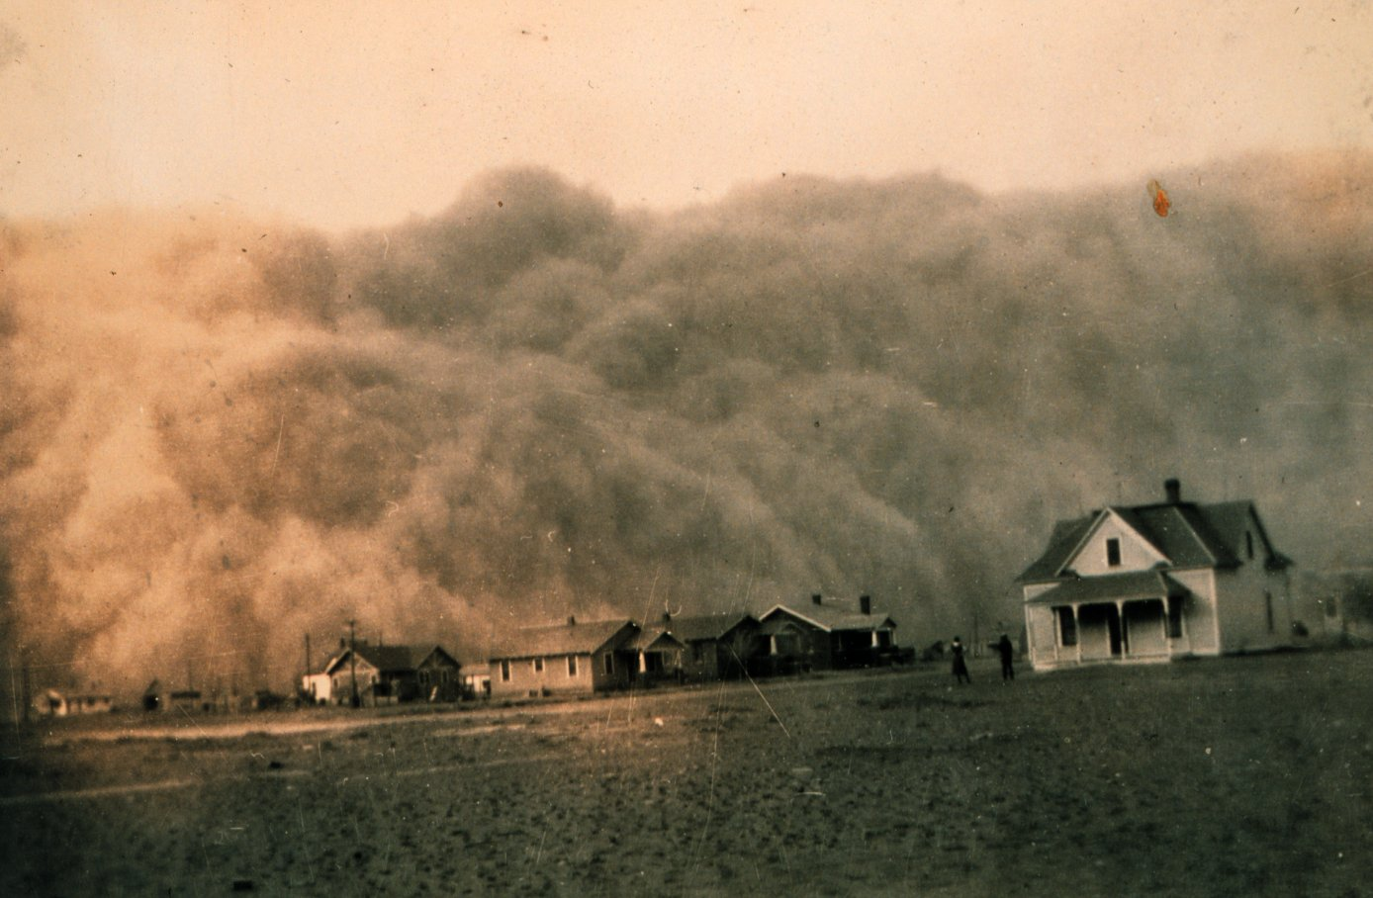
Dust storm approaching Stratford, Texas - 1934

Slide 25
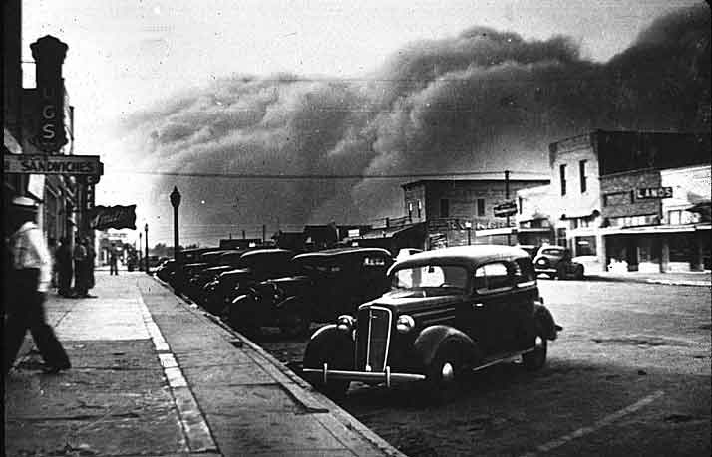
Storm approaching Elkhart, Kansas in 1937

Slide 26
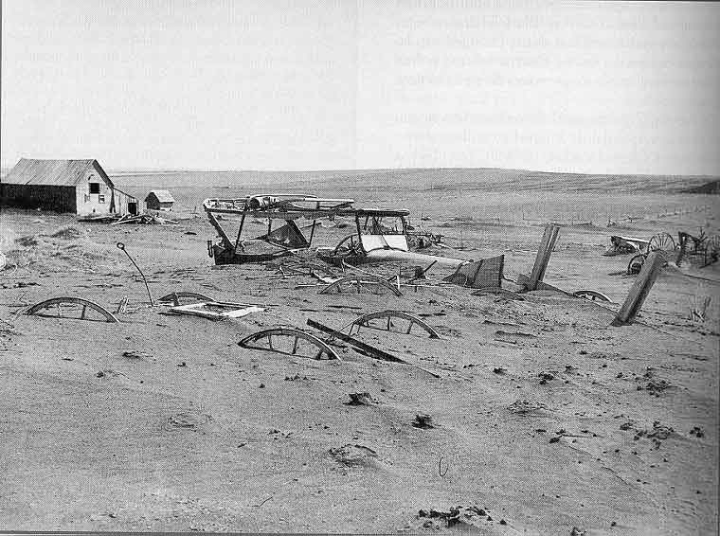
Dust buried cars and wagons in South Dakota in 1936

Slide 27
HARDEST HIT REGIONS
Kansas, Oklahoma, Texas, New Mexico, and Colorado were the hardest hit regions during the Dust Bowl
Many farmers migrated to California and other Pacific Coast states
Boy covers his mouth to avoid dust, 1935

Slide 28
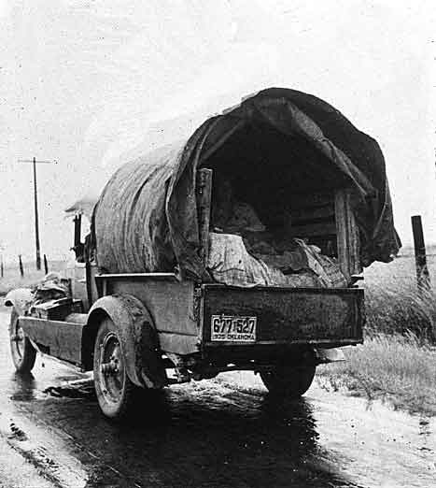
Photographer Dorothea Lange captures a family headed west to escape the dust storms

Slide 29
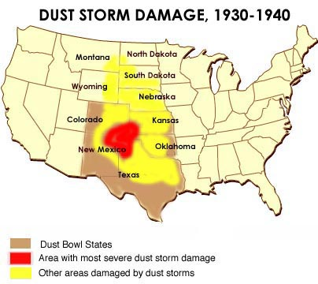

Slide 30
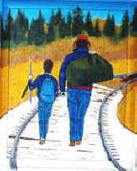
HOBOES TRAVEL AMERICA
The 1930s created the term “hoboes” to describe poor drifters
300,000 transients – or hoboes – hitched rides around the country on trains and slept under bridges (thousands were teenagers)
Injuries and death was common on railroad property; over 50,000 people were hurt or killed

Slide 31
EFFECTS OF DEPRESSION
Suicide rate rose more than 30% between 1928-1932
Alcoholism rose sharply in urban areas
Three times as many people were admitted to state mental hospitals as in normal times
Many people showed great kindness to strangers
Additionally, many people developed habits of savings & thriftiness

Slide 32
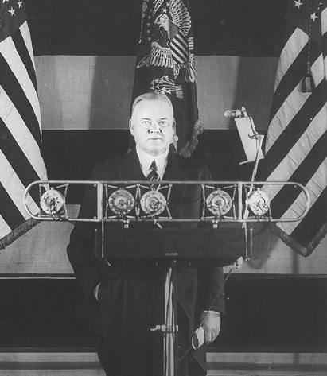
SECTION 3: HOOVER STRUGGLES WITH THE DEPRESSION
After the stock market crash, President Hoover tried to reassure Americans
He said, “Any lack of confidence in the economic future . . . Is foolish”
He recommended business as usual
Herbert Hoover

Slide 33
HOOVER’S PHILOSOPHY
Hoover was not quick to react to the depression
He believed in “rugged individualism” – the idea that people succeed through their own efforts
People should take care of themselves, not depend on governmental hand-outs
He said people should “pull themselves up by their bootstraps”
Hoover believed it was the individuals job to take care of themselves, not the governments

Slide 34
HOOVER’S SUCCESSFUL DAM PROJECT
Hoover successfully organized and authorized the construction of the Boulder Dam (Now called the Hoover Dam)
The $700 million project was the world’s tallest dam (726 feet) and the second largest (1,244 feet long)
The dam currently provides electricity, flood control and water for 7 western states

Slide 35
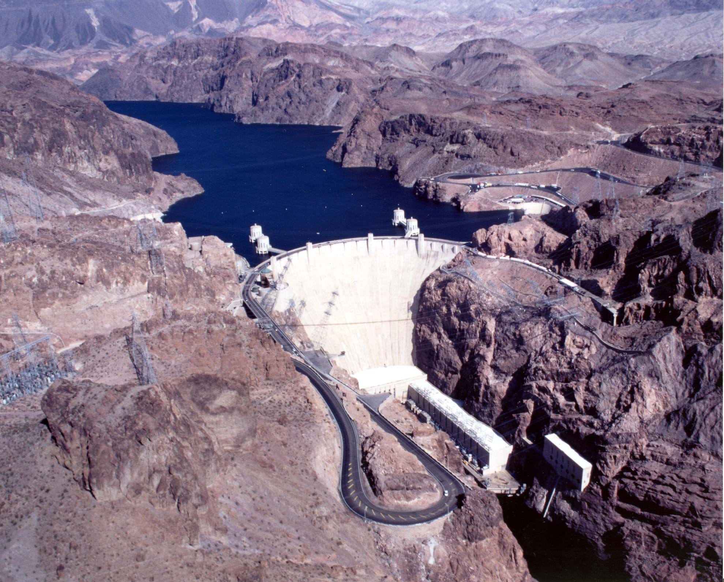
Any dam questions?

Slide 36
HOOVER TAKES ACTION: TOO LITTLE TOO LATE
Hoover gradually softened his position on government intervention in the economy
He created the Federal Farm Board to help farmers
He also created the National Credit Organization that helped smaller banks
His Federal Home Loan Bank Act and Reconstruction Finance Corp were two measures enacted to protect people’s homes and businesses
Hoover’s flurry of activity came too late to save the economy or his job

Slide 37
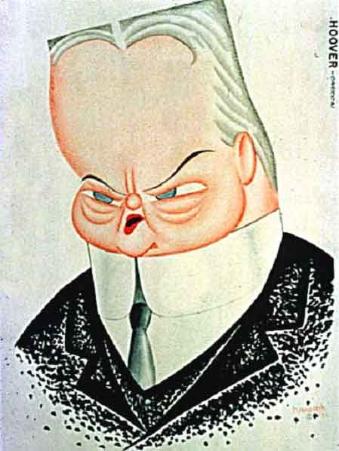
Hoover had little chance to be re-elected in 1932

