Slide 1
Imperialism and WWI
Imperialism and the Spanish-American War

Slide 2
Imperialism
A policy in which a stronger nation works to create an empire
Mid 1800s-early 1900s
Stronger countries dominate weaker nations/territories economically, politically, culturally and militarily
Factors that influence imperialism:
  Economic, nationalist, military and “humanitarian”

Slide 3
Economic Factors
An overall desire for raw materials and natural resources
By the late 1800s, Americans had more food and good than they could consume
  New markets could solve this problem
  New resources
US could gain political influence by investing in other countries

Slide 4
Nationalistic Factors
Imperialists use ideas of racial, national, and cultural superiority to justify imperialism
  Social Darwinism- certain nations and races were superior to others and were destined to rule over inferior peoples and culture
Americans feared the US was losing vitality, energy and spirit
  A quest for a larger empire could restore the country
  MONROE DOCTRINE (1823)- no Euro intervention in Western Hemisphere

Slide 5
Military Factors
To expand and protect their interests around the world imperialist nations built up their military strength
Alfred T Mahan- naval officer and called on the US to build a modern naval fleet
  steam powered, steel-hulled ships to protect overseas trade
  By 1900, US had 3rd largest Navy

Slide 6
“Humanitarian” Factors
Colonial officials, doctors, missionaries believed it was their duty to spread “blessings” of Western civilization
US used Social Darwinism to justify expansion
  Believed it was nation’s destiny to spread democracy and Christianity
  To “civilize the uncivilized”
  Super ethnocentric

Slide 7
Eyes on the Prize
Americans who pursued expansion focused on:
  Latin America
  Islands in the Pacific
  China

Slide 8
Opening up Japan
Matthew Perry- US naval commodore who successfully open Japan up to trade with the US in 1854
  Allowed the US to expand in the Pacific with trade and naval bases
  Helps modernize japan

Slide 9
Involvement in Latin America
US had strong interest there as a result of the Monroe Doctrine
  Stated that the US would oppose efforts by any outside power to control a nation in the Western Hemisphere
Within the US a sense of intense national pride and desire for an aggressive foreign policy developed

Slide 10
Spanish-American War
Marked the start of US Imperialism
War began after the American demand for Spain's peaceful resolution of the Cuban fight for independence was rejected

Slide 11
What Led to US involvement?
Yellow Journalism- newspapers used sensational headlines and exaggerated stories to promote readership
  Pulitzer and Hurst were main sources
  Encouraged Americans to sympathize with Cuban rebels who were compared to the patriots of the American Revolution

Slide 12
Cuba and the Spanish-American War
Cuba revolted against rule by Spain- led by Jose Marti
  Yellow Journalism-sensational reporting that exaggerated the new to enrage readers
    Used to make American public sympathize with Cuba and fight Spain
U.S. declares war on Spain b/c:
  De Lome Letter- insulted US President McKinley- angered American public
  U.S.S. Maine- US naval ship that exploded in Havana- 260 sailors killed
    Was an accident but reporters blamed Spain

Slide 13
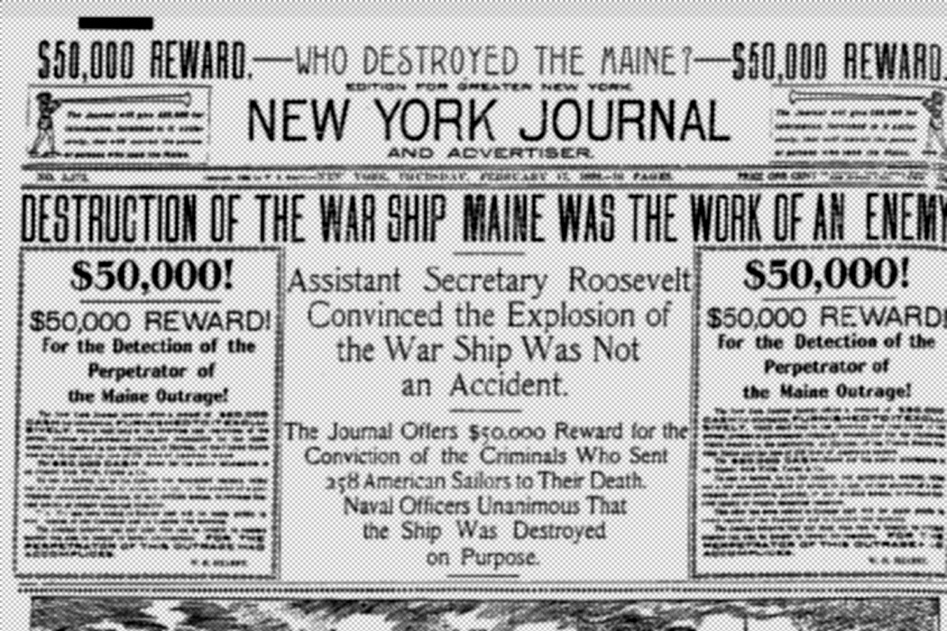
Yellow Journalism

Slide 14
What led to US involvement?
deLome Letter- American newspapers printed a letter from Spanish Ambassador that called President McKinley “weak”
U.S.S. Maine- battleship sent to Havana when riots broke out to rescue American citizens
  Exploded in the harbor and sank, killing over 250 Americans
    Blamed the Spanish and called for war

Slide 15
The Spanish-American War
Congress recognized Cuban independence
  Authorized force against Spain
  Began in April 1898
Teller Amendment- stated that the US had no intention of annexing (taking) Cuba
US destroyed Spain's entire pacific fleet
American troops invaded Cuba

Slide 16
Rough Riders and San Juan Hill
Teddy Roosevelt led 1st volunteer Cavalry known as the Rough Riders
  Included cowboys, miners, policemen, and college athletes
TR and the RR charged up San Juan Hill
  Most famous incident in war
  Spanish surrendered shortly after

Slide 17
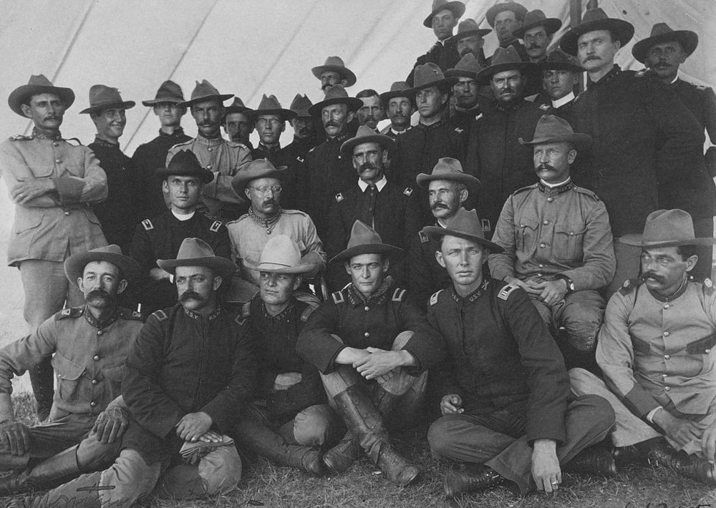

Slide 18
Spanish-American War-1898
U.S. navy defeated Spanish navy in the Philippines
U.S. army defeated Spanish army in Cuba
  San Juan Hill- US victory that featured a cavalry charge by Teddy Roosevelt’s “Rough Riders”
Treaty of Paris (1899)
  Cuba received independence from Spain
  US got territories in Philippines, Guam, and Puerto Rico
  Spain got $20 million from US
Significance: US = major world power

Slide 19
Back to Cuba…
Platt Amendment- US asserted the right to intervene in Cuban affairs
  Significance: US made Cuba a “protectorate”- a country whose affairs are partially controlled by a stronger power

Slide 20
Teddy Roosevelt
“Big Stick Diplomacy”- use diplomacy when possible but have a strong military to back up your policies if needed- “speak softly and carry a big stick”
Roosevelt Corollary- added to Monroe Doctrine
  Said that US would be the police power in the Western Hemisphere in dealing with Latin American countries
  Hurt relations with Latin American countries

Slide 21
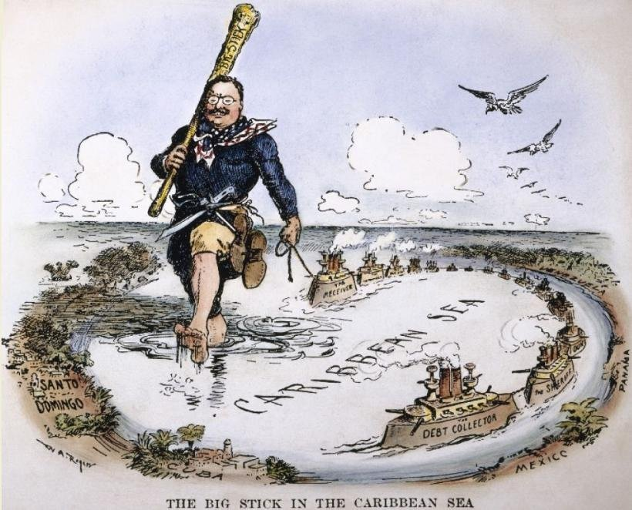

Slide 22
William Howard Taft
“Dollar Diplomacy”- Taft urged American banks and businesses to invest in Latin America
  Promised business interests that the US would intervene in investments were threatened
Significance: hurt relations between Latin American countries and the US

Slide 23
US in Latin America
President Roosevelt wanted to build a canal across isthmus of Panama
  Would provide a shorter route between Atlantic and Pacific
    Make shipping faster
    Ease naval transportation
  1st tried to purchase land from Columbia (owned Panama at the time)
    Columbia would not sell

Slide 24
Panama Canal
America started revolt for Panamanian Independence
  Gave aid to Panamanians
  Angered many Americans
US paid Panama $10 million for the canal zone, leased land for $250,000 each year for 99 years
US paid Columbia $25 million for lost territory
Opens in 1914 (as war breaks out)

Slide 25
Acquiring New Lands- Panama
US (and Pres. Teddy Roosevelt) wanted a canal across Central America
  Goal was the shorten the distance, time and cost between Atlantic and Pacific
  US encouraged and supported Panama rebellion against Columbia
Panama Canal- built by US and opened in 1915
  US paid Panama $10 million for the canal zone, leased land for $250,000 each year for 99 years
  US paid Columbia $25 million for lost territory
Sig: Canal was success but hurt US relations with Latin America

Slide 26
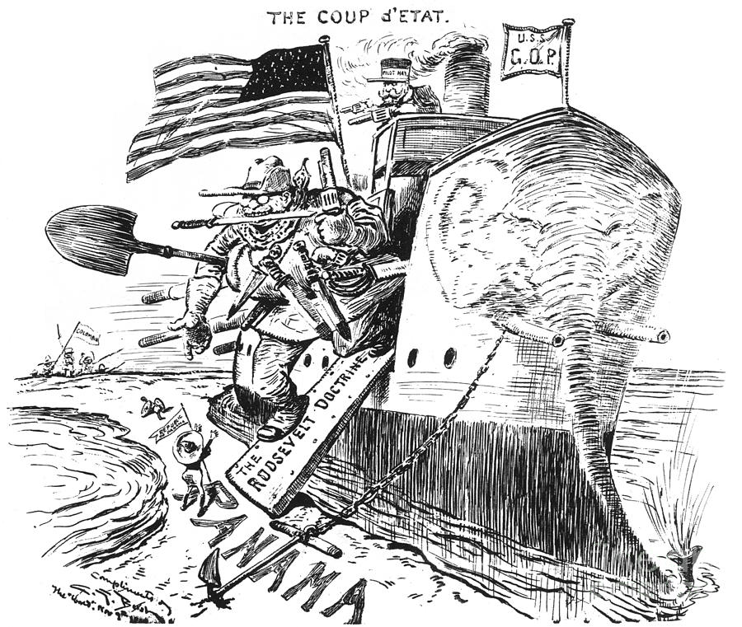

Slide 27
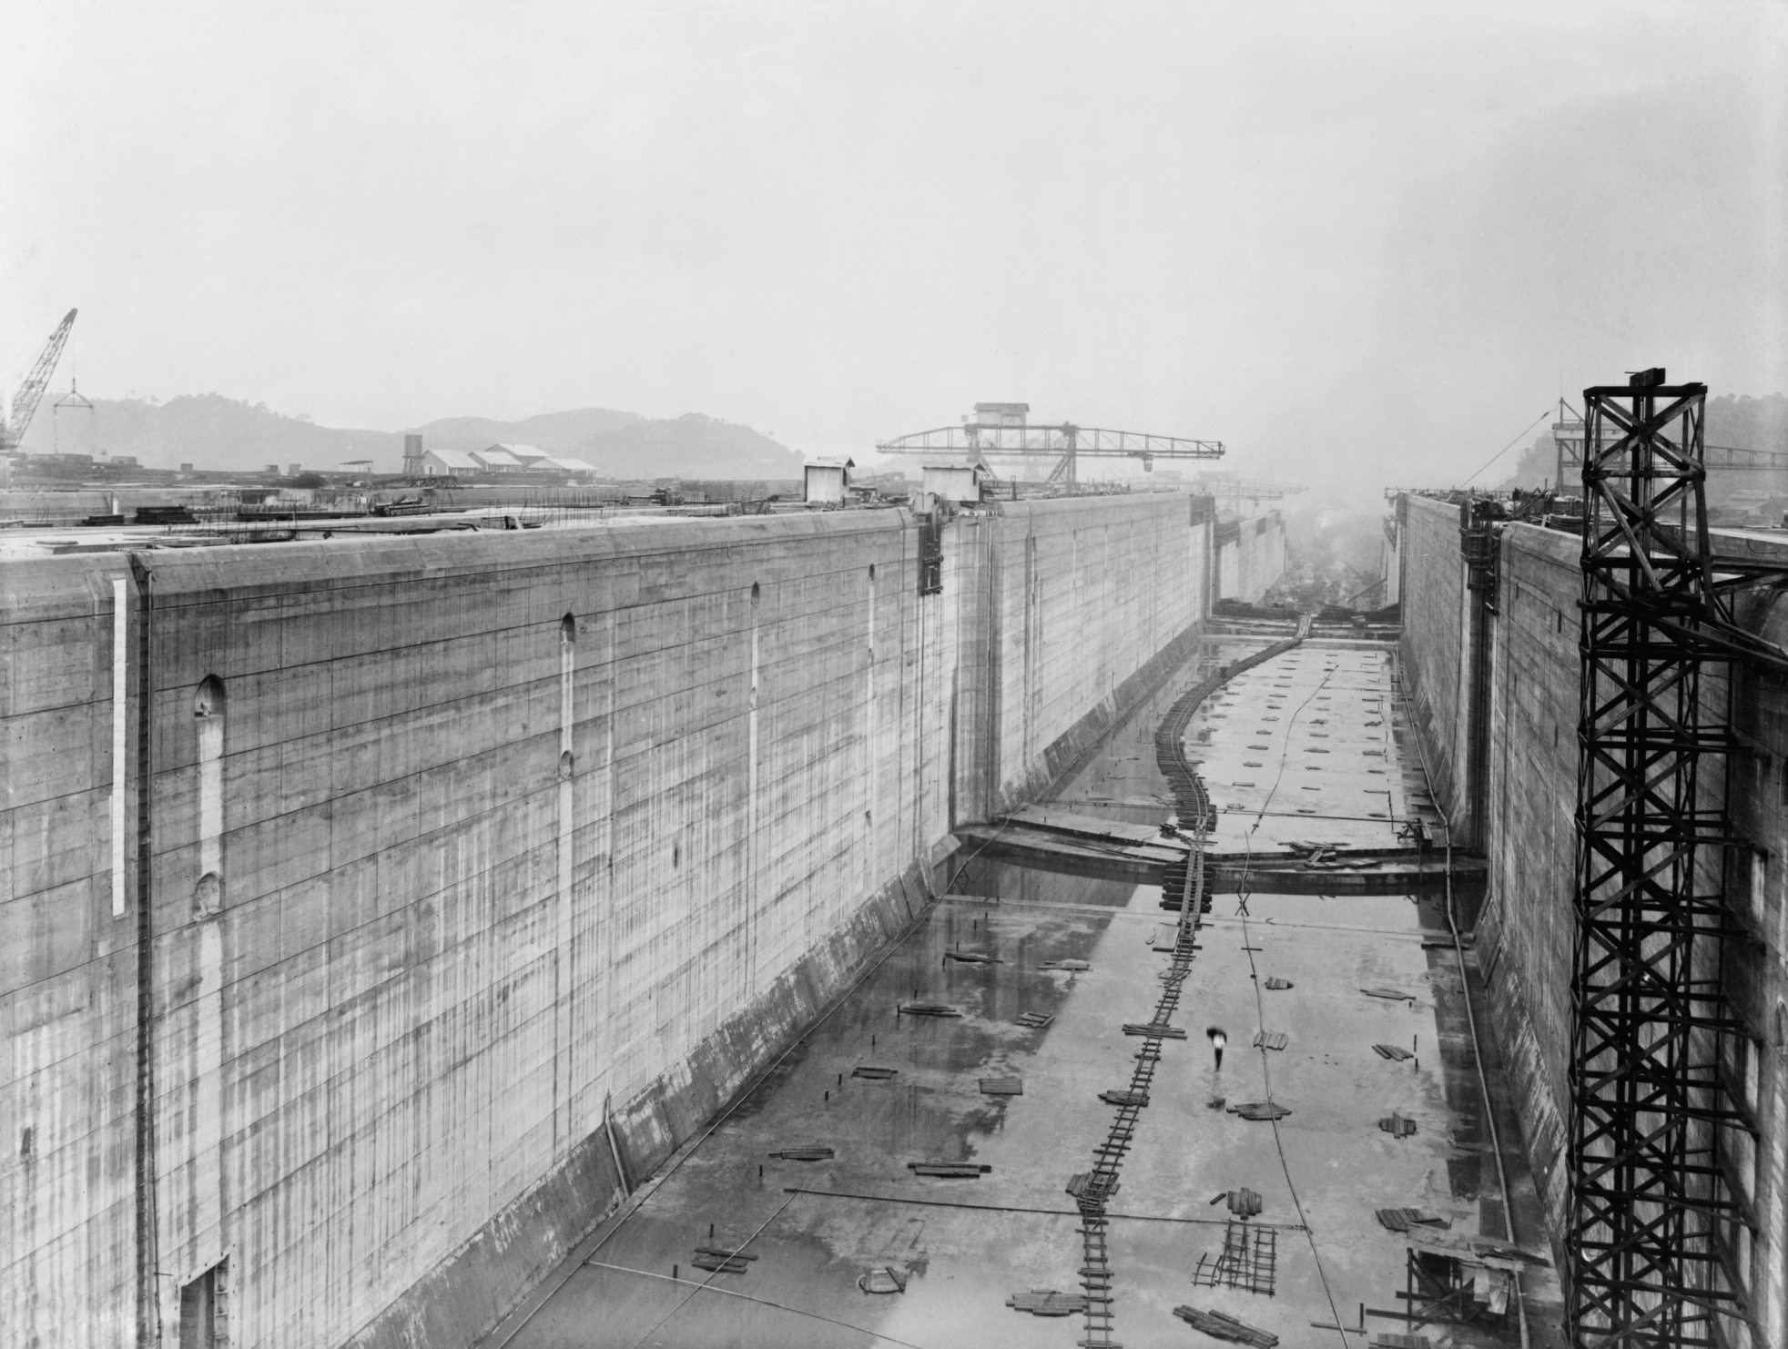

Slide 28
Puerto Rico
Foraker Act- law establishing a civil government in Puerto Rico
  Puerto Rico had been under direct US military rule
  Act authorized the US president to appoint a governor and part of the legislature

Slide 29
Acquiring New Lands-China
China viewed as potential market for US goods
  Open Door Policy (1899)- developed by Secretary of State John Hay, stated that all nations should have equal trading rights to China- China should be “open” to everyone
    Goal was to end “sphere of influence” by European powers and Japan

Slide 30
An Open Door to China
European nations and the US were interested in creating “spheres of influence”- areas of economic and political control (by an outside power) in China
  Britain, France, Germany, and Russia had carved China into spheres of influence to avoid competing for trade
    Threatened to limit US trade in China

Slide 31
Leave the Door Open
John Hay (US Sec of State) proposed the Open Door Policy to keep trade open for the Americans who were too late to the party
Favored open trade relations between China and other nations
Would ensure that the US would have equal access to China’s consumers
Rejected by many European counties

Slide 32
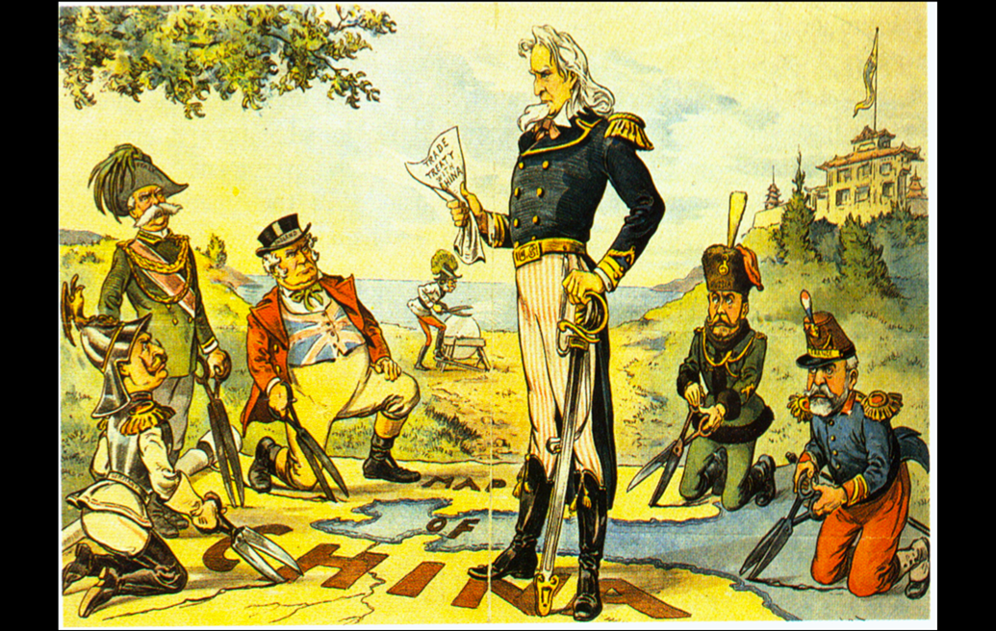

Slide 33
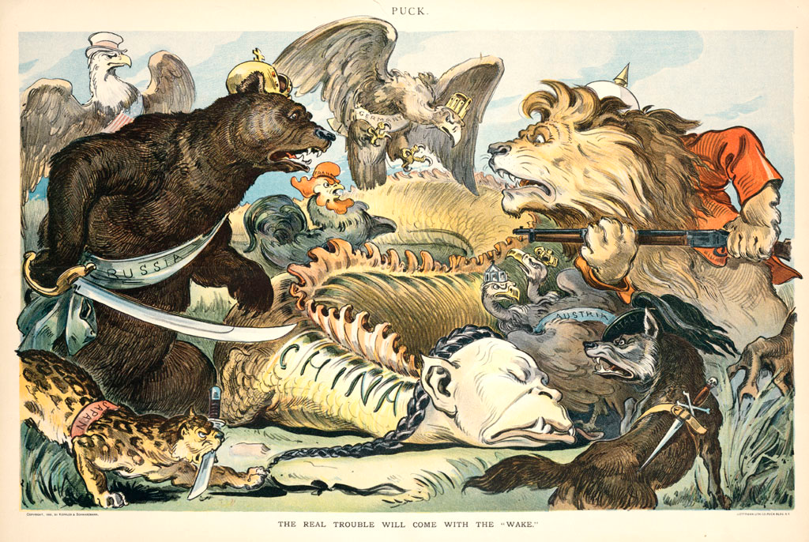

Slide 34
Boxer Rebellion
Presence of foreigners caused resentment and some in China joined secret societies
  Celebrated traditional customs and criticized western ways
  One society (the Boxers) killed foreign missionaries in May 1900 and more violence broke out
  Prompted the gov’ts of Europe and America to send troops to stop the rebellion
    Fueled Chinese nationalism

Slide 35
US Acquires Alaska
William Seward, Sec. Of State under Lincoln and Andrew Johnson was a big supporter of imperialism
In 1867, Seward arranged for the US to buy Alaska from the Russians for $7.2 million
  Some people thought it was silly and called it “Seward's icebox” or “Seward's folly”
Alaska didn’t become a state until 1959
Alaska was rich in timber, minerals and oil

Slide 36
Hawaii
Important stepping stone to Asia
Overthrew Queen Liliuokalani
Annexed in 1898
Became the 50th state in 1959

Slide 37
Hawaii
Hawaii was important to the U.S. b/c:
  location– half way to China
  U.S. wanted to establish a naval base- Pearl Harbor
US military helped overthrow Hawaiian Queen Liliuokalani
Annexation complete by 1898- territory NOT A STATE

