Slide 1
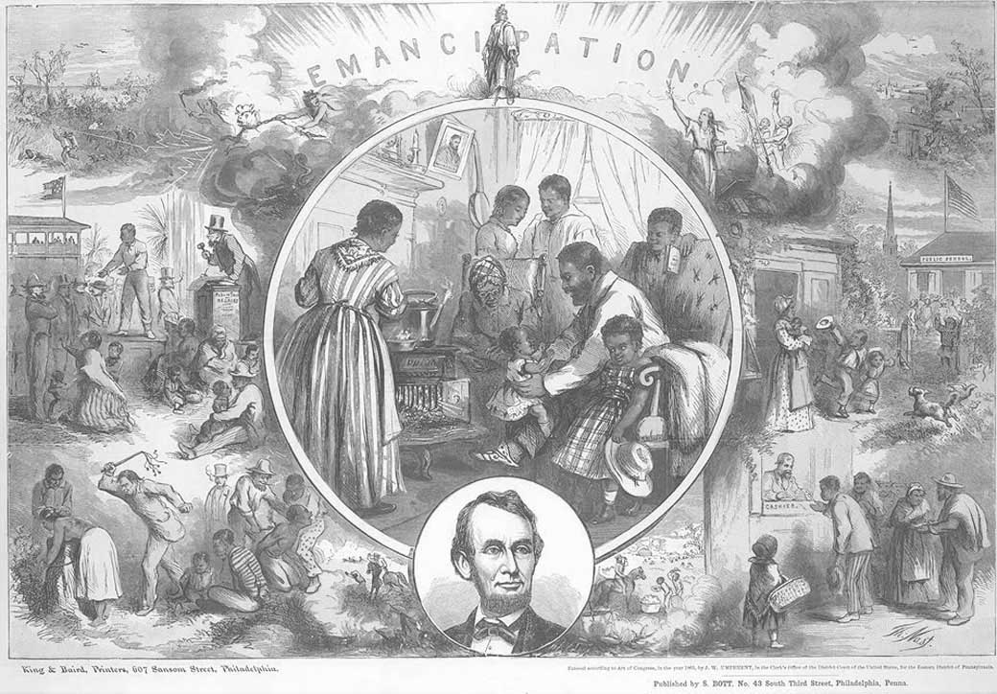
Reconstruction
1865-1877

Slide 2
Reconstruction Begins
Reconstruction: The time period after the Civil War when the United States began to rebuild the South. (1865-1877)
Goals of Reconstruction:
  To bring the Southern states back into the United States.
  To rebuild the South (buildings, bridges, roads, etc.).
  To protect the civil rights of African Americans.
    Slavery ended, but discrimination continued.

Slide 3
Reconstruction Begins
At the end of the Civil War, the southern states were treated as a defeated foreign nation.
Southern states would have to rejoin the United States.
Southerners had to regain their United States citizenship by taking a loyalty oath to the United States.

Slide 4
Reconstruction
The Political Parties
Republicans: Abraham Lincoln’s political party.
  Wanted to help African Americans in the South by
    Protecting their civil rights.
    Providing them with an education.
    Protecting them from the racism and discrimination of ex-Confederates.
  Most Republicans lived in the North.
  Northern whites, African Americans, and some Southern whites were Republicans.
Democrats: The party of the South.
  Did not want to grant African Americans civil rights.
    They wanted to segregate African Americans from the white population.
    Did not want to give African Americans the right to vote.
    Did not want African Americans to have equal rights.
  Most Democrats were white southerners.
  Many ex-Confederates were Democrats, and they wished to regain power in the South after the Civil War ended.

Slide 5
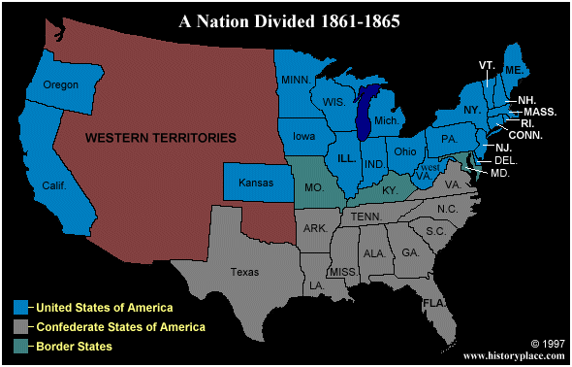
Reconstruction Begins

Slide 6
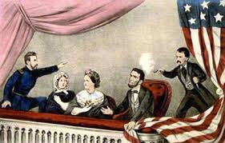
Reconstruction Begins

Slide 7
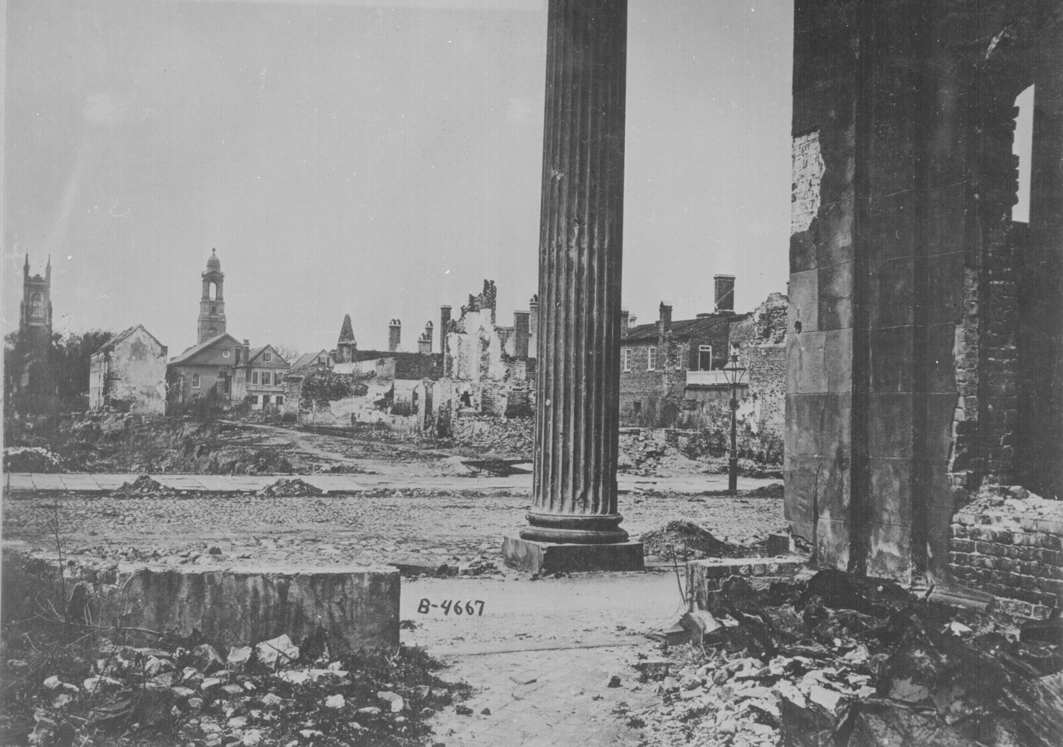
Reconstruction Begins

Slide 8
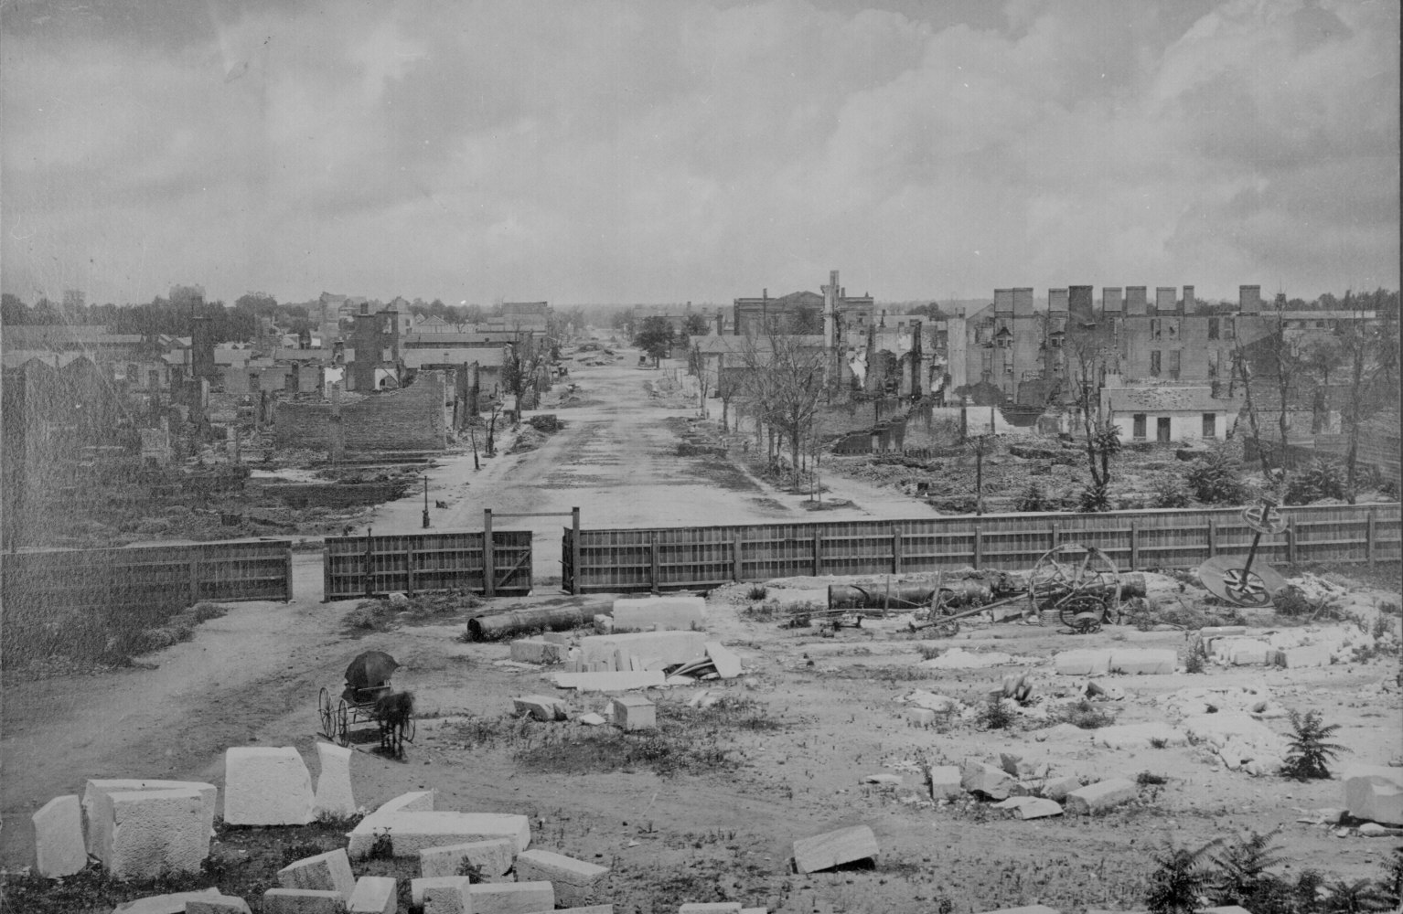
Reconstruction Begins

Slide 9
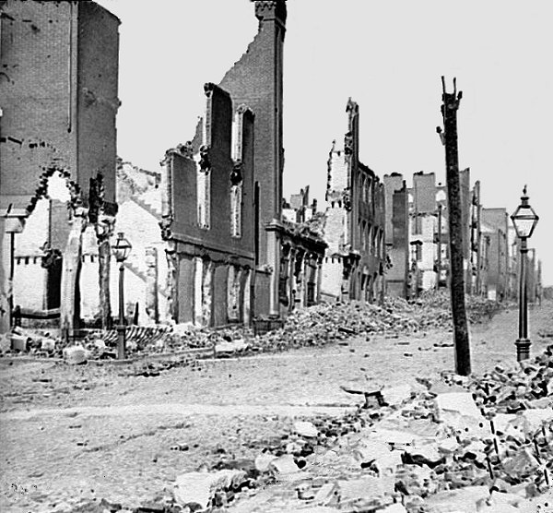
Reconstruction Begins

Slide 10
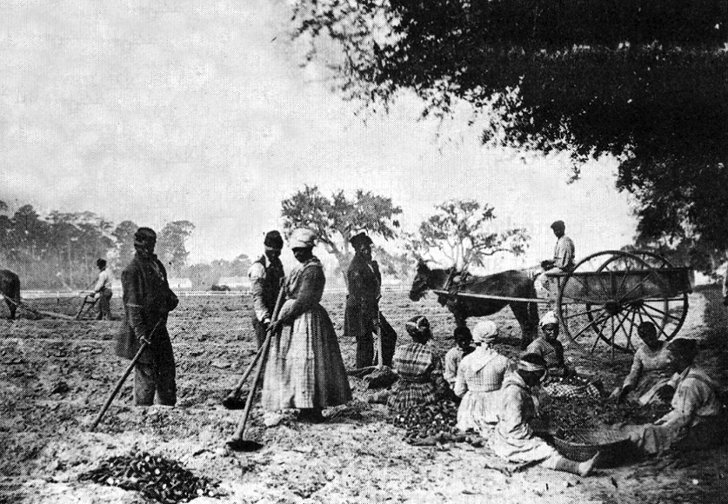
Reconstruction Begins

Slide 11
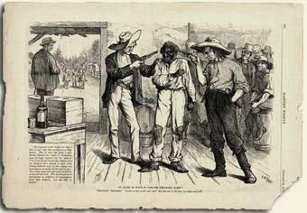
Reconstruction Begins

Slide 12
Reconstruction
Presidential Reconstruction vs. Congressional (Radical) Reconstruction
President Lincoln wanted to forgive the South, and make it easy for them to rejoin the United States.
Lincoln’s Reconstruction Plan: The Ten Percent Plan.
  Southerners had to take a loyalty oath to the United States.
    Southern states can set up a new government and be readmitted to the United States after 10 percent of the state took the loyalty oath.
  Southern states had to ratify the 13th Amendment.
  Only high-ranking ex-confederate officials would be punished (cannot run for office or vote in elections)
However, due to his assassination, Lincoln never got the chance to put his plan into action.

Slide 13
Reconstruction
Presidential Reconstruction vs. Congressional (Radical) Reconstruction
Following Lincoln’s death, Andrew Johnson, the Vice President of the United States, became the 17th President of the United States of America.
President Andrew Johnson decided to continue Lincoln’s plan for Reconstruction.
  Presidential Reconstruction

Slide 14
Reconstruction
Presidential Reconstruction vs. Congressional (Radical) Reconstruction
However, a large group in Congress was against Johnson, they were known as Radical Republicans.
  Radical Republicans: A group of Republicans in Congress that wanted to punish the South for the Civil War and provide African Americans with equal rights.
Radical Republicans had several goals.
  They wanted to punish ex-Confederates in the South (cannot run for office or vote in elections).
  They wanted African Americans to have more rights in the United States.
    They wanted African Americans to be granted the right to an education and the right to vote.
    They wanted African Americans in the South to be given to land so they can become farmers, have a job, and earn money.
Radical Republicans did not support Presidential Reconstruction, they instead wanted to start Congressional (Radical) Reconstruction, a Reconstruction program controlled by Congress.

Slide 15
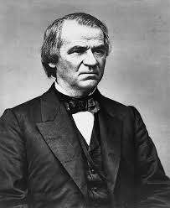
Presidential Reconstruction
1865-1867

Slide 16
Reconstruction
Presidential Reconstruction
In January 1865, Congress passed the 13th Amendment. The 13th Amendment outlawed slavery in the United States of America.
  Amendment: A change or addition to the United States Constitution.
All states ratified (agreed) to the 13th Amendment by December 1865.

Slide 17
Presidential Reconstruction
At first, it seemed as if President Johnson would be a good and fair Reconstruction president. However there were problems.
  Johnson granted pardons to ex-Confederate officials (Democrats).
  These ex-Confederate officials (Democrats) were able to vote in elections, and run for office.
  The Southern states then elected the ex-Confederates (Democrats) to office.
  The ex-Confederates (Democrats) created laws that discriminated against African Americans in the South.
These laws were known as The Black Codes.
  The Black Codes: Laws that limited the civil rights of African Americans. Under these laws, African Americans were not able to hold good jobs, go to school, vote, or serve on juries.

Slide 18
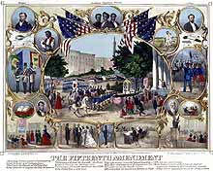
Congressional (Radical) Reconstruction
1867-1876

Slide 19
Reconstruction
Congressional (Radical) Reconstruction
The Radical Republicans in Congress became angered by Johnson’s forgiveness of the ex-Confederates (Democrats) who now regained power in the South (Southern state governments).
Congress started to pass bills that allowed them to take control over the Reconstruction process. By 1867, President Johnson no longer controlled Reconstruction.
Congressional (Radical) Reconstruction had started. The Radical Republicans in Congress now controlled the Reconstruction process.

Slide 20
Reconstruction
Congressional (Radical) Reconstruction
In Congress, the Radical Republicans began passing laws to protect the rights of African Americans.
The Freedman’s Bureau: A government agency that was created to help African Americans and poor whites in the South.
  Provided African Americans with job training, schools, and protection from white southerners.
The Civil Rights Act (1866): African Americans are given the same equal rights as white Americans in the United States.
The 14th Amendment (1868): Granted African Americans citizenship in the United States.
  All people born in the United States are citizens.
  A state cannot take away the rights of an American citizen (protection from the Black Codes).
  If a state prevents a citizen from voting, they will lose their representation in Congress.
  Ex-Confederate leaders cannot hold office.

Slide 21
Reconstruction
Congressional (Radical) Reconstruction
The Reconstruction Acts (1867-8):
  Placed the South under military rule. The South was divided into five military districts and occupied by the United States Army.
  All adult African American males were granted the right to vote.
  Ex-Confederate politicians were not allowed to vote or hold office.
  Southern states had to approve the 14th Amendment in order to be allowed to rejoin the United States, and for military occupation to end.
    All southern states were readmitted to the United States by 1870.

Slide 22
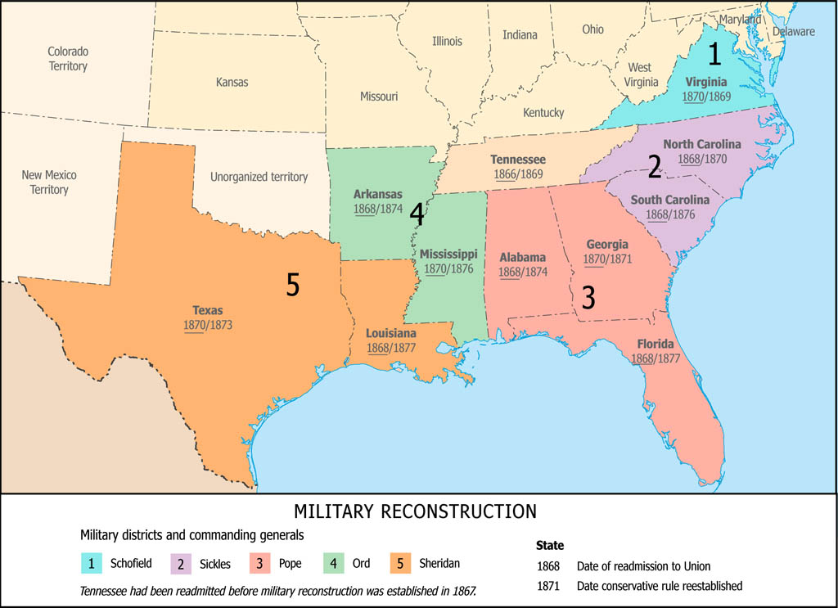
Reconstruction
Congressional (Radical) Reconstruction

Slide 23
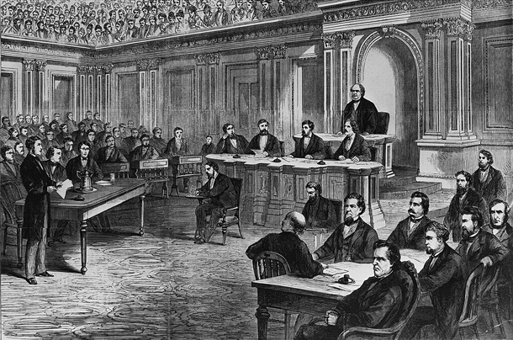
Reconstruction
The Impeachment of President Johnson

Slide 24
Reconstruction
The Impeachment of President Johnson
President Johnson made several decisions during Presidential Reconstruction that angered the Radical Republicans, including
  Allowing ex-Confederate politicians to regain power in the South.
  Trying to veto the 14th Amendment, the Civil Rights Act, and the Reconstruction Acts, laws passed by the Radical Republicans in Congress.
  Trying to fire one of his cabinet members (Edward Stanton, Secretary of War, a Radical Republican)

Slide 25
Reconstruction
The Impeachment of President Johnson
The Radical Republicans wanted to remove President Johnson from office.
The Radical Republicans impeached President Johnson for violating (breaking) the tenure of office Act (law) (1867).
  Impeachment: To bring the President of the United States to court for a crime.
  Tenure of Office Act (1867): A law that said the President must be given permission from Congress to remove one of his cabinet members.
President Johnson was impeached on February 24, 1868. He was tried in the Senate, but he was saved from being removed from office by one vote.
Andrew Johnson remained in office, but his reputation was damaged, and he could no longer try control Reconstruction, Congressional (Radical) Reconstruction would remain in place.

Slide 26
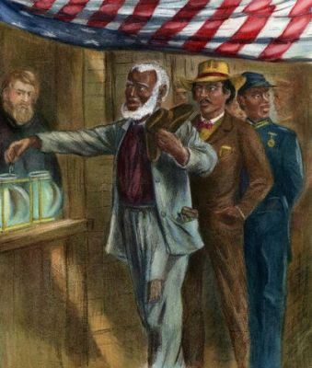
“Black Republican” Reconstruction

Slide 27
Reconstruction
“Black Republican” Reconstruction
In 1868, Ulysses S. Grant, the former Union General, was elected the 18th President of the United States.
Shortly after his election, the Radical Republicans passed the 15th Amendment.
The 15th Amendment (1870): African Americans are granted the right to vote.
  The right to vote cannot be denied “on account of race, color, or previous conditions of servitude.”
  African Americans were protected from white Southerners by the United States Army.
Once African Americans were given the right to vote, they joined the Republican Party – The party of Lincoln.

Slide 28
Radical Reconstruction:
“Black Republican” Reconstruction
For the first time in American History, large numbers of African Americans were allowed to not only vote in an election, but also hold public office in the South.
  265 African American men are elected to public office in the South (Federal, state, and local government)
  2 African Americans are elected to the United States Senate.
  16 African Americans are elected to the United States House of Representatives.
  In South Carolina, African Americans controlled the state legislature.
The Republican Party gained control of the South from white Democrats (ex-Confederates).

Slide 29
Radical Reconstruction
“Black Republican” Reconstruction
Two new groups formed in the South.
Carpetbaggers: People from the North (white and black) who went to the South to start schools, build railroads, and protect the civil rights of African Americans.
Scalawags: Were white Southerners who joined the Republican Party and cooperated with the Radical Reconstruction.
  Ex-Confederate politicians (Democrats) blamed them for allowing Northerners and African Americans to take control of the state governments.

Slide 30
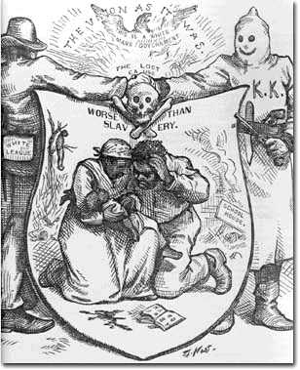
The Democrats take control of the South

Slide 31
Reconstruction
The Democrats take Control of the South
Sharecropping: A new farming/economic system developed in the South following the end of the Civil War.
  White landowners (plantation owners) could no longer use slaves to farm their property.
  Plantation owners divided their property up into small units and rented out each unit to a African American family.
  But African Americans had no money to buy tools or supplies with.
  The landowner would give the African American family tools, seeds, a house, clothes, and supplies to farm their unit of land.
  In return, the African American family would have to give half of their crops to the white landowner to pay for rent and supplies.
  If an African American family needed more supplies, they would have to give up even more than half of their crops to the white landowner.
The white landowners did not have to do any work, the African American families renting out their land did all of the work for them.
  What does this sound like?

Slide 32
Reconstruction
The Democrats take Control of the South
By 1868, many Northerners lost interest in Reconstruction, they were concerned with other problems in the country.
By 1870, all the Southern states had rejoined the united States.
Radical Republicans began to lose their power in Congress.

Slide 33

Reconstruction
The Democrats take Control of the South
In 1868, white Southerners formed terrorist organizations to frighten African Americans from taking part in politics (voting, running for political office).
The most famous of these terrorist groups was the Ku Klux Klan (KKK).
  The Ku Klux Klan used violence to scare African Americans.
  If an African American was running for office or voting in an election, they faced numerous punishments from the KKK, including
    Being attacked.
    Murdered.
    Or having their house burnt down.
    The KKK also burnt down black churches in the South.
Congress passed the Force Acts (1870-1) to protect African Americans from white terrorist organizations. But terrorist groups continued to hurt and kill African Americans in the South for taking part in politics.

Slide 34
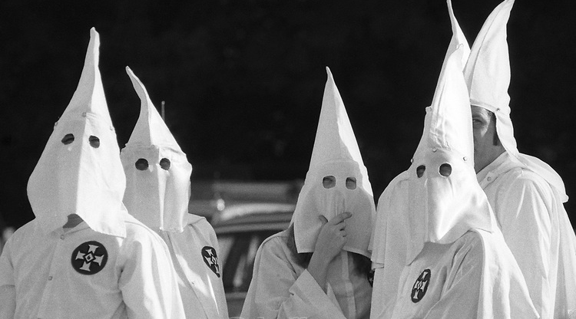

Slide 35
Reconstruction
The Democrats take Control of the South
The Election of 1876: Rutherford B. Hayes (Republican) vs. Samuel Tilden (Democrat)
Tilden won the popular vote, but the electoral votes from four states were disputed (due to corruption by both Republicans and Democrats).
  Florida, Louisiana, South Carolina, and Oregon.
Tilden won 184 electoral votes, and Hayes won 165 electoral votes. 20 electoral votes were left over.
Congress created a special committee to resolve the election (Republicans and Democrats).

Slide 36
Reconstruction
The Democrats take Control of the South
The Democrats and Republicans agreed to a compromise.
The Compromise of 1877: Southern Democrats allowed Rutherford B. Hayes to become President, if he agreed to several demands.
  The United States Army had to leave the South.
  Hayes had to appoint a Southerner to his cabinet.
  Hayes had to supply the south with money to rebuild and industrialize their economy.
Rutherford B. Hayes agreed to the compromise and was declared the 19th President of the United States.
President Hayes removed the United States Army from the South, Reconstruction was ended.
However, African Americans no longer had the army to protect them from white terrorist groups and discrimination by white Southern Democrats.

Slide 37
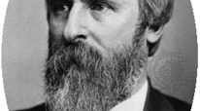

Slide 38
Reconstruction
The Democrats take Control of the South
The End of Reconstruction for African Americans:
  After the Compromise of 1877, white Southern Democrats were able to regain control of the state governments.
  White southern Democrats passed several laws to segregate and discriminate against African Americans.
    Poll Taxes: A tax paid before someone can vote.
    Jim Crow Laws: Laws passed by southern state governments that segregated African Americans and whites.
      African Americans were not allowed to use the same schools, restaurants, hospitals, hotels, and trains as white southerners.

Slide 39
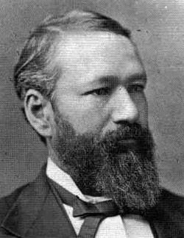
Plessy vs. Ferguson

Slide 40
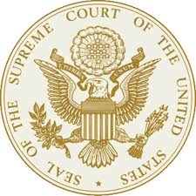
Case
Homer Adolph Plessy was accused of sitting in the white section of a train when he was 1/8 black, which was not legal
Case went to the Supreme Court

Slide 41
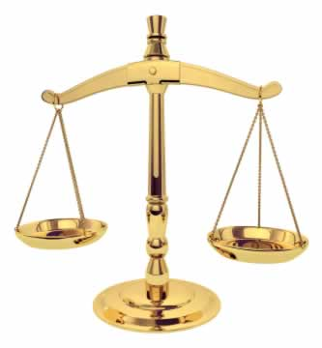
Arguments
Plessy argued in court that the Separate Car Act violated the Thirteenth and Fourteenth Amendments to the Constitution. | Ferguson was the judge. He decided that the state could choose to regulate railroad companies that operated solely within the state of Louisiana. Therefore, Ferguson found Plessy guilty and declared the Separate Car Act constitutional.
PLESSY
FERGUSON

Slide 42
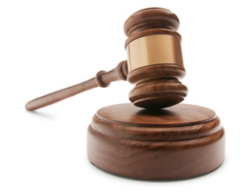
Supreme Court Decision
Plessy appealed the case to the Louisiana State Supreme Court, which affirmed the decision that the Louisiana law as constitutional. Plessy petitioned for a writ of error from the Supreme Court of the United States. Supreme Court named the case Plessy v. Ferguson because of the petition that Plessy made.

Slide 43
Plessy v. Ferguson
The Supreme Court ruled segregation was legal in Plessy v. Ferguson.
They said that segregation was fair as long as “separate-but-equal” facilities were provided for African Americans.
In practice, the African American facilities were usually “separate-and-unequal.”
It would take until the 1965, 100 years after the Civil War ended, for Jim Crow laws to be outlawed and blacks to finally realize legal equality in America.

Slide 44
Reconstruction
The Democrats take Control of the South
Reconstruction: Success or failure?
Goals of Reconstruction:
  To bring the Southern states back into the United States.
    Success
  To rebuild the South.
    Success
  To protect the civil rights of African Americans.
    Failure

