Slide 1
Imperialism and WWI
US Involvement in WWI

Slide 2
Causes of WWI (1914-1918)
Militarism Alliances Imperialism Nationalism
Militarism- During the 1800s militarism had increased around the world, making nations eager to use military force. Most nations had built massive armies and navies with the latest technology. Britain and Germany had the biggest arms race.
Alliances- Europe was made up of a system of alliances that kept the balance of power in Europe. Nations agreed to defend each other if attacked. This meant that a war between two nations could escalate into a global conflict.

Slide 3
Causes Continued
Imperialism- The European powers, Russia and Japan competed from economic power in the 1800s. France and Germany competed for colonial gain in Africa, while Britain and Germany competed industrially.
Because of their mutual competition with Germany, Britain and France formed close ties with each other.
Nationalism- Aggressive nationalism was the source of tension throughout Europe. Many French people wanted to take revenge against Germany and regain Alsace and Lorraine. Because of nationalism, the region of the Balkans was known as the “powder keg” of Europe.

Slide 4
Nationalism Definition
Devotion to the interest in your own country

Slide 5
The War Begins~ The Spark
Not surprisingly, WWI began in Bosnia, which was the heart of the ethnically diverse Balkan power keg. Although inhabited by many Serbs, Bosnia was not ruled by Serbia, but by Austria.
When Francis Ferdinand, the heir to the Austro-Hungarian throne, traveled through Bosnia in June 1914, he was assassinated by Serbian nationalist Gavirilo Princip. The assassination of Ferdinand is known as the “spark” that started the Great War.

Slide 6
German War Plan- Schlieffen Plan
Germany was faced with a two front war in 1914, with Russia to the east and France to the west. German army general Schlieffen organized a battle plan designed to take on both France and Russia.
The idea was to quickly defeat France first, and the defeat the Russians. German generals predicted Russia would be slow to mobilize due to a lack of industrialization and a shortage of railroads.

Slide 7
German War Plan continued
In order for the plan to work, German armies had to march through neutral Belgium, which was protected by Great Britain. Once Germany invaded Belgium, GB declared war.
Just as planned, Germany swept through Belgium. However, Russia mobilized much quicker than expected. To fight the Russians, Germany had to divert some of its forces to the east, which weakened their forces on the western front.

Slide 8
Horrors of War
Trench Warfare led to all types of new horrors on and off the battlefield. Many soldiers suffered from shell shock (combination of lack of sleep and the horrible conditions).
The trenches were filthy; infested with rats, polluted water, gas, dead bodies. Men would now be at risk of trench foot from standing in cold, damp mud and not changing socks

Slide 9
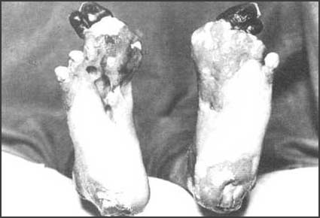
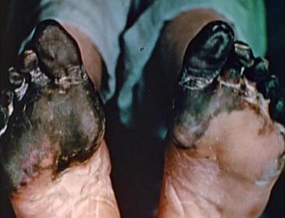

Slide 10
Wilson Urges Neutrality
Officially the US remained neutral and preferred to maintain their tradition of isolation from European disputes.
Isolationism: remaining neutral or out of other countries affairs
Cultural Ties- the US had more similarities with the Allies than with the Central Powers (Allies: GB, FR, Russia (kinda), IT----- Central: Germ, Aust-Hung, Ottoman Empire)

Slide 11
Neutrality Gives Way to War
In 1917, the neutral United States declared war on Germany for several reasons:
Unrestricted submarine warfare- Germany began sinking allied ships by using its U-Boats, or submarines.
Lusitania- the Germans sunk the large ocean liner, and did not halt unrestricted submarine warfare
Americans on board

Slide 12
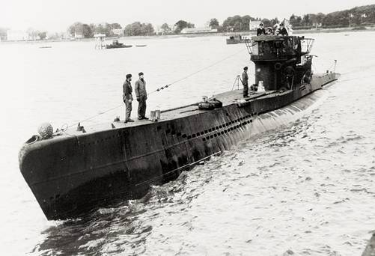
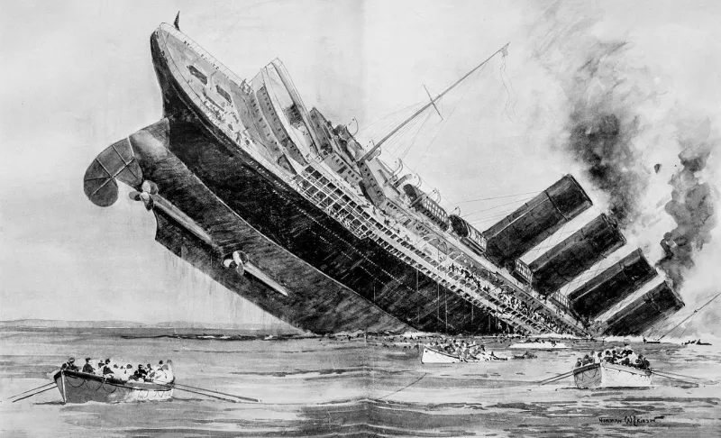

Slide 13
3. Zimmerman telegram- The British intercepted a message from Arthur Zimmermann, the German Foreign Minister, to his ambassador in Mexico
Zimmermann asked for Mexican support and promised that in return Germany would help Mexico conquer New Mexico, Texas and Arizona
Historical Significance: These 3 actions by Germany made it so Wilson could no longer call for peace.

Slide 14
America Mobilizes for War
When the US entered WWI, the U.S. Army was only a fraction of the size of European armies. President Wilson encouraged Americans to volunteer for service and pushed Congress to pass the Selective Service Act (military draft)
24 million registered for the draft and 3 million were drafted.
500,000 women joined the workforce for the first time
400,000 African Americans left the rural South for industrial jobs in the North – Great Migration

Slide 15
War Industries Board
The WIB was headed up by Bernard M. Baruch. The WIB encouraged factories to use mass production techniques to increase efficiency and set price controls on products.
Effect of the WIB: Wages went up but the cost of living went way up because of the rising cost of food and housing.

Slide 16
Committee on Public Information
Propaganda department headed by George Creel. The CPI designed, printed and distributed millions of posters that dramatized the needs of America and its allies.
Creel and the CPI’s job was to combine education and widespread advertising to “sell America”. The CPI also stressed the cruelty and wickedness of the enemy (specifically Germany)

Slide 17
CPI Continued
Creel and the CPI conducted the greatest sales job ever! Governments were left to find ways to make the war popular for their citizens- besides songs they also used art. Propaganda posters were widespread and targeted all sorts of groups.
Effects of CPI- new policies
Work or Fight!
“Sweetless, Meatless, Wheatless, and Heatless”
Victory Gardens

Slide 18
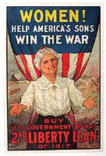
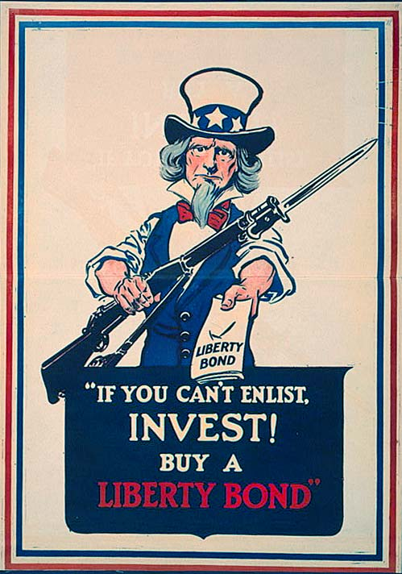

Slide 19
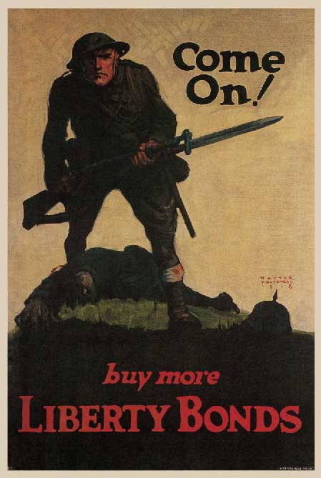
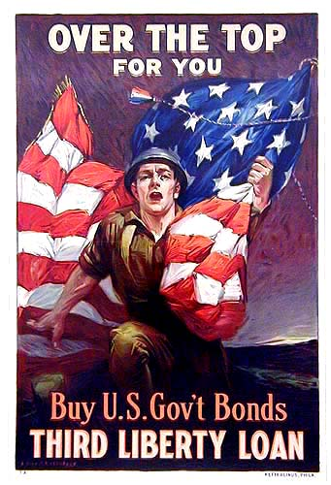

Slide 20
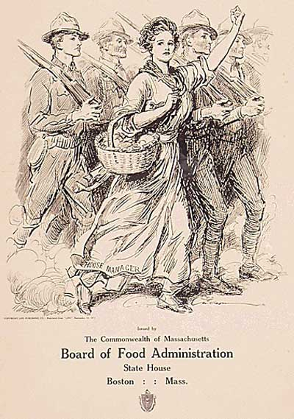

Slide 21
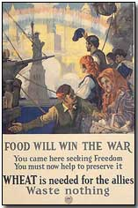
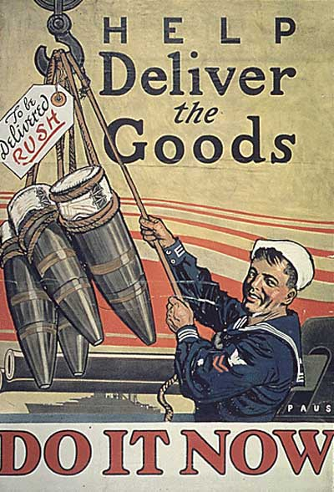
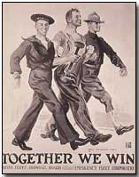
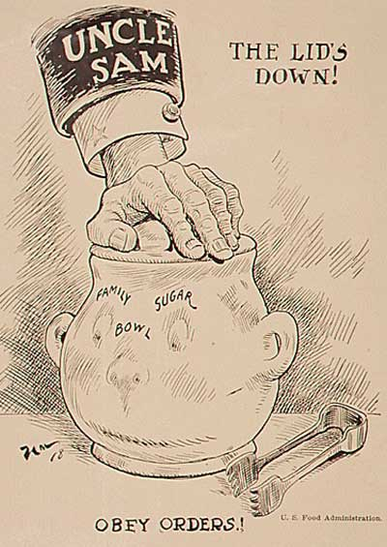

Slide 22
Opposition and its Consequences
The CPI posters and speeches intensified by portraying Germany as the cruel enemy. Some Americans wrongly generalized that all German people were cruel. Americans stopped teaching German in public schools and we stopped playing Beethoven.
Hamburgers= “Liberty Steaks”
Dachshunds= “Liberty Pups”
German Measles = “Liberty Measles”

Slide 23
Espionage Act of 1917
Made it a crime:
To convey information with intent to interfere with the operation or success of the U.S. armed forces or to promote the success of its enemies.
To convey false reports or statements with intent to interfere with the operation or success of the US military when the US is at war,
To cause or attempt to cause insubordination, disloyalty, mutiny, or refusal of duty, in the US military,
To willfully obstruct the recruiting or enlistment service of the United States.

Slide 24
Schenck v. U.S. (1919)
Charles Schenck oversaw, printing and mailing more
than 15,000 leaflets to men about to be drafted into WWI.
The leaflets urged men not to submit to the draft, "Do not submit to intimidation” "Assert your rights", "If you do not you are helping to deny rights which is the
solemn duty of all citizens and residents of the US"
Schenck also urged men not to comply with the draft
on the grounds that forced military service constituted “involuntary servitude” which is prohibited by the
13th Amendment.
After a jury trial Schenck was convicted of violating Section 3 of the Espionage Act of 1917.

Slide 25
Schenck v. U.S. (1919)
He appealed to the Supreme Court arguing that his
conviction, and the statute which purported to authorize it, were contrary to the 1st Amendment.
He relied heavily of the text of the First Amendment, and their claim that Espionage Act of 1917 had what today we would call a "chilling effect" on free
discussion of the war effort.
Supreme court rejected Schenck's argument, saying the criminal conviction was constitutional.

Slide 26
Schenck v. U.S. (1919)
The First Amendment did not protect speech encouraging insubordination, because the circumstances of wartime permit greater restrictions on free speech than would be allowed during peacetime.
“The most stringent protection of free speech would not protect a man in falsely shouting fire in a theatre and causing a panic…”The question in every case is whether the words used are used in such circumstances and are of such a nature as to create a clear and present danger that they will bring about the substantive evils that Congress has a right to prevent.
SCOTUS’ decision in Schenck was a “landmark”
that influenced future 1st amendment cases.

Slide 27
FREE SPEECH & STUDENTS…
TINKER V. DES MOINES:
Question – Does prohibiting the wearing of armbands as a form of symbolic protest violate students’ free speech?
Conclusion: Yes.
Majority position: Armbands represent a type of “pure speech” that is allowed. School officials did not substantially prove that their conduct would “materially & substantially interfere” with school operations.
Dissenting position: Wearing armbands distracted students & staff from their work so the district was OK to discipline the students.

Slide 28
Free speech & students…
BETHEL V. FRASER:
Question: Does 1st Amendment prevent the school from disciplining a student who uses obscene speech at a HS assembly”
Conclusion: NO.
Majority Opinion: It is appropriate for a school to prohibit vulgar/offensive language even when its not “political” speech because such language is inconsistent with the fundamental values of public education.”
Dissenting Opinion: In this case, the dissenters were not convinced the student was fully aware of the consequences of his violation. If that is the situation, then the speech – even if it is vulgar – may be protected.

Slide 29
Free speech & students…
MORSE V. FREDERICK:
Question: Does 1st Amendment allow public schools to prohibit students from displaying messages that promote the use of illegal drugs @ school supervised events?
Conclusion: Yes
Majority Opinion: School officials can prohibit messages that promote illegal drug use; free speech law does not extend to pro-drug msgs. that may undermine the school’s mission to discourage drug use.
Dissenting Opinion: unfettered debate must be permitted, even among high school students. In this case dissenters felt his sign was a “nonsense message, not advocacy.”

Slide 30
Similarities to Schenck case?
Yes and no…if a student’s words create a clear and present danger at school, their speech will NOT be protected by the first Amendment; however –
The SC has applied limits to free speech more strictly when it comes to students because schools have a special responsibility to assure a safe learning environment for all – so – if a student’s speech/expression threatens the school’s ability to do that…the SC has not protected that speech.

Slide 31
The Tides Turn
Due to horrible military defeats, hunger and chaos within Russia, a communist revolution occurred against the Czar in 1917. Communist leader Vladimir Lenin pulled Russia out of the war, which greatly upset the other Allies.

Slide 32
Germany Defeated
The Germans are closing in on Paris, but the Americans come to the rescue. In 1918 the Allies slowly pushed the Germans back, who were exhausted of men and materials

Slide 33
America’s Greatest Hero
Trapped behind enemy lines, Alvin York was being blistered with machine gun fire. York took out the machine gunner with his rifle and stormed the German position with only a pistol. York took the German position at amazing odds. York won the Congressional Medal of Honor

Slide 34
US Gives the Allies the Edge
Austria-Hungary surrendered first in 1918, which just leaves Germany. Soldiers for Germany deserted or just refused to fight anymore. Then Germany on 11th hour of the 11th day of the 11th month in 1918 signed an armistice.

Slide 35
Costs of War
The war cost the US $35.5 billion, which was to be paid by taxpayers and war bonds

Slide 36
The “Big Three”
Wilson wanted “peace without victory,” and wanted defeated nations to be treated well to avoid a war of revenge in the future. Wilson introduced America’s goals his Fourteen Points, which were admired by the Germans, but not the other Allies.
Wilson wanted to eliminate the basic causes of war, such as conflicts over nationalism and imperialism. Wilson also called for an end to alliances, a reduction of military arms, and self-determination

Slide 37
Wilson’s Plan
Eleventh day, eleventh hour in eleventh month (Nov. 11)
Met at the Palace of Versailles on January 1918
Allies met to decide the peace terms
Central Powers and Russia were not invited
Wilson presented his plan called the “Fourteen Points” on January 18, 1918
Goal was to eliminate the causes of WWI

Slide 38
Fourteen Points included:
Freedom of the Seas- all nations should have equal access to water trade routes
Self-Determination- culturally/ethnically similar people should choose for themselves how to for their own nation and gov’t
Mandate System- process for Allied powers to oversee transition of former colonies and imperial possessions to independent nations
League of Nations- international organization to address diplomatic issues without going to war

Slide 39
Debating the Treaty of Versailles
Wilson’s focus was the Fourteen Points, while GB and France wanted to punish Germany
What was included in the treaty:
9 new nations created (Poland, Czechoslovakia, Yugoslavia, etc.)
Germany stripped of its army
Germany forced to accept the war guilt clause- accept blame for starting the war
Germany required to pay $33 billion in reparations- payment of war damages
League of Nations

Slide 40
The Treaty’s Weakness
The treaty humiliated Germany and they remained bitter and angry
Italy and Japan are angry b/c they felt like they should have been given more land
Russia was left out of the talked
New communist gov’t under Vladimir Lenin was determined to get taken land back

Slide 41
Opposition to the Treaty
When Wilson returned home many were unsatisfied with the peace treaty
Democrats supported the treaty (Wilson was a Dem)
Republicans were split- strong isolationist feeling
“Irreconcilables”- opposed it outright
Revisionists- opposed mainly the League of Nations

Slide 42
Isolationists
Henry Cabot Lodge- Republican Senator- opposed to the part of the treaty dealing with the League of Nations
Argued that the US would lose the right to declare war for itself, and instead, be dragged into future European conflicts by the LoN

Slide 43
Wilson Refuses to Compromise
Wilson refused to compromise on the League
Wilson traveled throughout the nation explaining why the US should join the League
On Oct. 2, 1919 Wilson suffered a stroke and was weakened
Senate voted against the treaty
The US never joined the League and decided to sign a separate treaty with Germany in 1921

Slide 45
Legacy of War
America emerges as an Industrial Giant
The Treaty of Versailles settled nothing
France and Great Britain got their way and punished Germany harshly
Germany, Italy, Japan and Russia were left bitter

